Slide 1



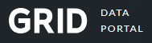
Victory Vision
Revamped
Dana Fulmer, Shayne Powell, Aaron Swan, Spencer Buck, Sal Sonmez

Slide 2
The Goal
⇒Our goal was to further determine whether or not it is possible to predict the victorious party of a singular match-up or tournament. This was done through the access of multiple APIs that contain large collections of statistics for different competitive Video Games (eSports). The data gathered was then cleaned and put through alternate models(XGBoost, Neural Network, etc.).

Slide 3
GRID API

Slide 4
GRID API
⇒GRID API is an API built to strictly provide competitive multiplayer game data. The API tracks every heartbeat of a game directly into their server databanks.
⇒Games we had available:
Counter Strike 2
Dota 2
⇒Examples of Paid API Games:
League of Legends
Valorant
PlayerUnknowns Battlegrounds (PUBG)

Slide 5
CS2 Analytics
Shayne Powell

Slide 6
Data Cleaning
⇒To Clean the data we cycled through the data collected, and either removed and/or encoded the object values into numerical values
One Hot Encoder
Label Encoder
⇒We then removed the players collected that had 0 in all stats beside player_id

Slide 7
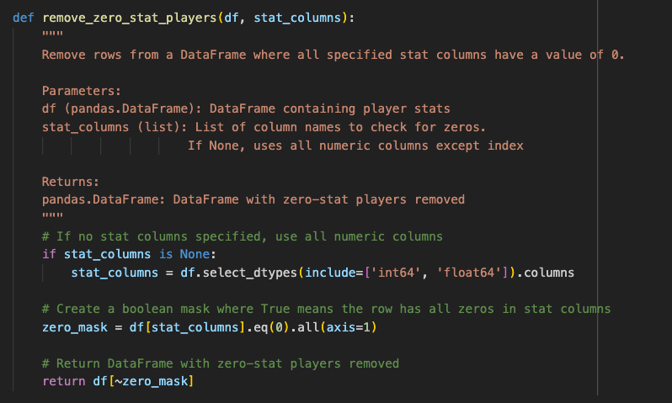
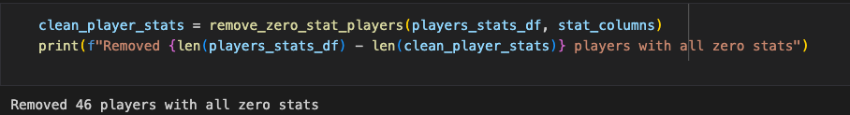
All Zero Stat Removal Command
484 players
46 players with all 0 stats
438 players with all stats accounted for

Slide 8
Feature Selection
⇒The Features that were said to positively influence the predictions, found through Feature Selection, PCA, Mutual Information, and Stability selection were:
Data used: Player Stats Data
Most of the data was kill-death-win oriented
Best Features for Model Building:
'series_count', 'game_count', 'kills_per_game', 'deaths_per_game', 'avg_kills', 'avg_deaths'

Slide 9
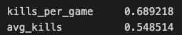
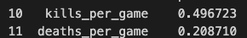
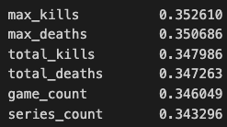
Visuals. . . (From Feature Selection)
<Correlation with kdr
<Importance
<PCA components
*Note:
max_kills, max_deaths, total_kills, total_deaths were not used as they more directly correlate with KDR, and we already use kills and deaths per game

Slide 10
XGBoost + Neural Network
⇒We had originally assumed that the data predictions would be more accurate if we filtered the data through both an XGBoost model and a Neural Network model.
⇒The results were worse than anticipated as proven by the mean_squared_error of the combination model’s predictions.
144.69810634111252
Mean squared error at such a large area means that the predictions are significantly far/different from the original data

Slide 11
XGBoost
⇒Despite the combination model not working as anticipated, we decided to test a singular model, this time being XGBoost Regressor to make predictions.
⇒The results for the singular model were much better. The mean_square_error of just XGBoost is much lower than the combined models.
0.007714637396182838
.007 instead of 144.7

Slide 12
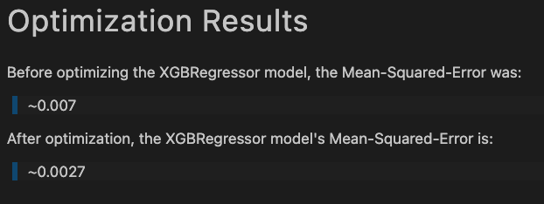
XGBoost Optimization
⇒Since XGBoost was the better model to use in order to make predictions in regards to KDR, that was the model chosen from Optimization.
⇒A function was set up to cycle through optimization tactics, and the results are appeasing.
The mean squared error was reduced by approximately 61%

Slide 13
CS2 and DOTA Analytics
Dana Fulmer

Slide 14
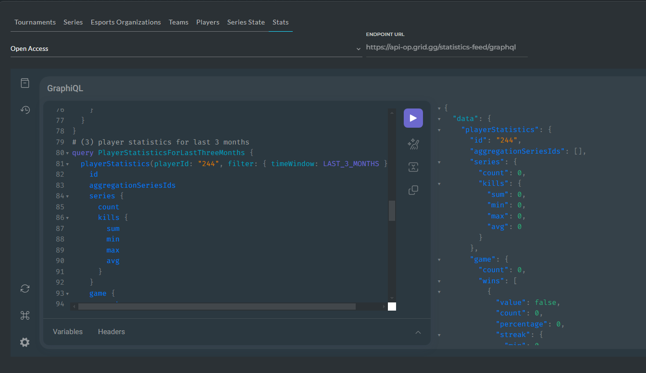
Comprehensive Data Deep Dive
Gathered comprehensive stats for all players via API, not limited to specific games.
Filtered out extensive(over 55 batches of 50 players) zero values to refine dataset.
Expanded data variety: more stats available for analysis.
Challenges: Data nested differently per game, requiring careful extraction.

Slide 15

Data Integration for Enhanced Analysis
Integrated filtered player data (title IDs) with cleaned player stats (only player ids +stats no game info).
Dropped unnecessary columns from player data.
Joined data on player_id.
Split dataset by title_id (CS2, Dota).
Manually renamed DataFrames.
Pickled DataFrames for future use.

Slide 16
Feature Analysis for Enhanced Data Insights
Performance Metrics: Avg. Kills/Deaths, Win Rates.
Utility Metrics: Objective-Focused Actions (CS2: Defuses, Plants).
Dota Experience Metrics: Total Games Played, Consistency Scores.
- Descriptive Analysis: Summarized key statistics for performance, utility, and experience metrics to understand player behavior and contributions.
- Correlation Analysis: Identified relationships between metrics, such as the link between high kill averages and win rates or objective completions and team success.
- Player Segmentation: Used clustering to group players by performance and experience, uncovering distinct profiles like high-impact fraggers and objective specialists.
Dota Player Base: 299 players
CS2 Player Base: 1469 players

Slide 17
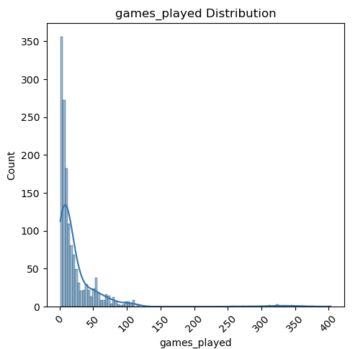
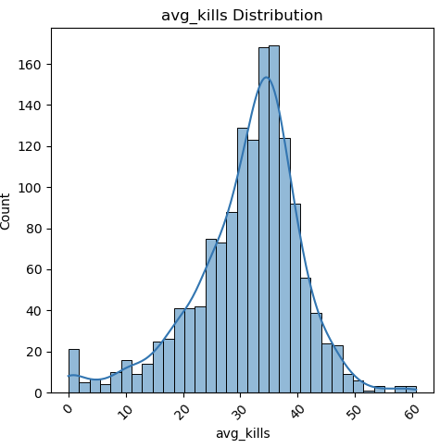
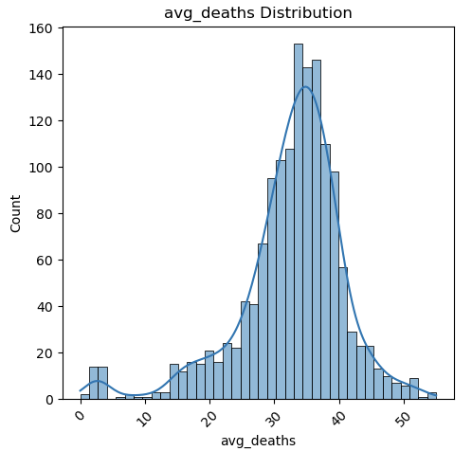
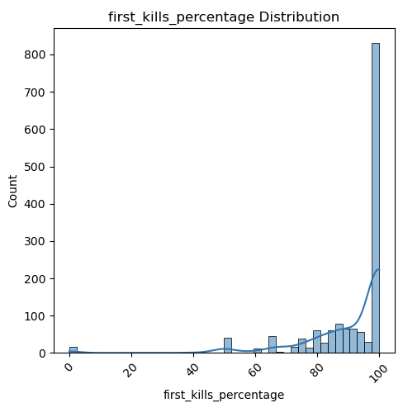
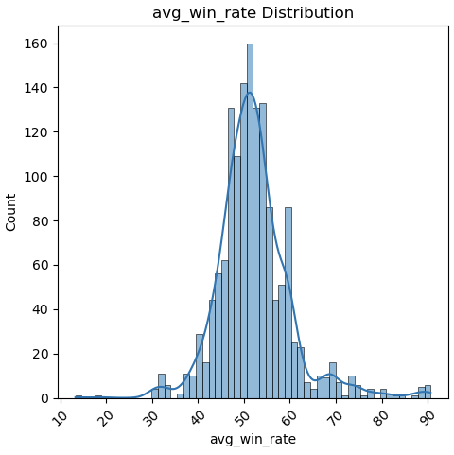
Avg Performance Score:
205 (Top: 430)
Avg Kills per Game:
31 (Top Performers: ~40+)
Avg Win Rate:
52% (Top Performers: ~47%-53%)
CS2 Graphs

Slide 18
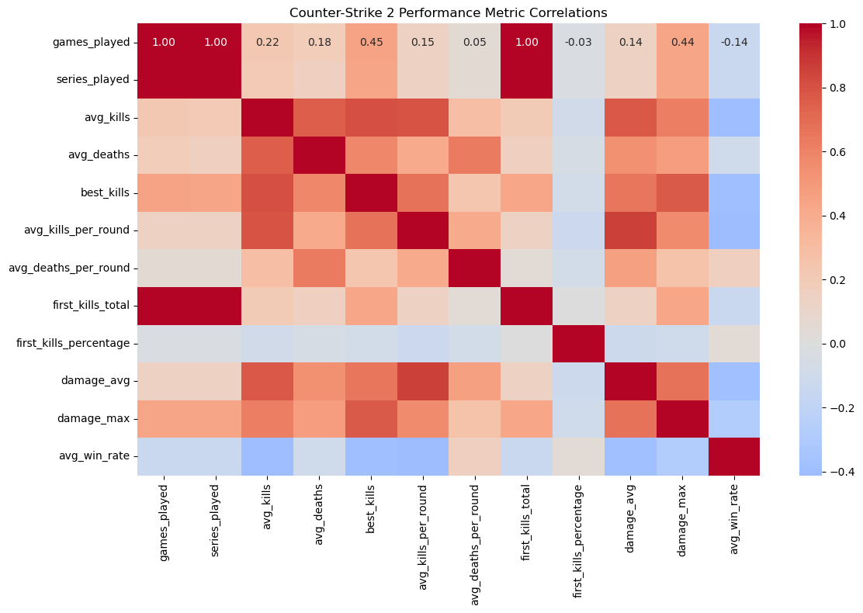
CS2 Heat Map

Slide 19
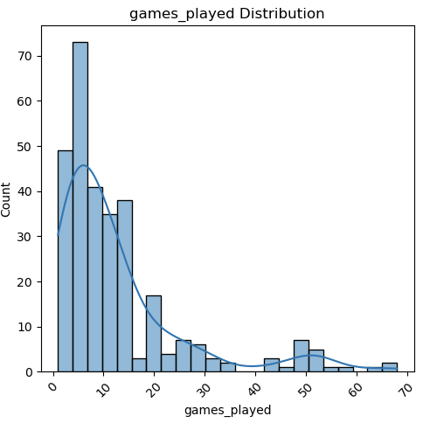
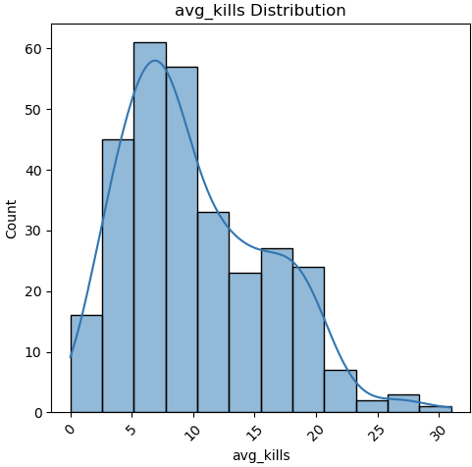
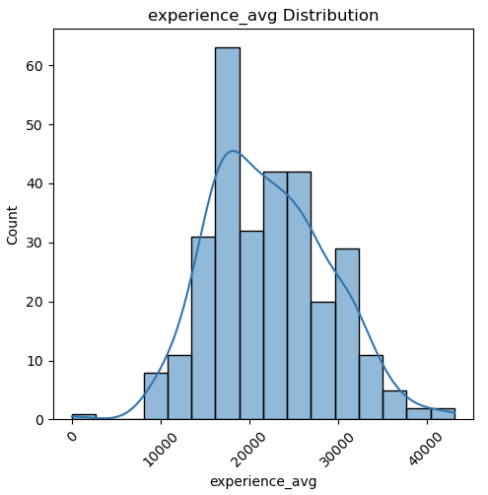
Role Metrics Summary:
Carry Rating: Avg ~26,685, Top ~59,849
Early Game Rating: Avg ~0.44, Top ~1.0
Game Impact: Avg ~1.20, Top ~14.05
Dota Graphs

Slide 20
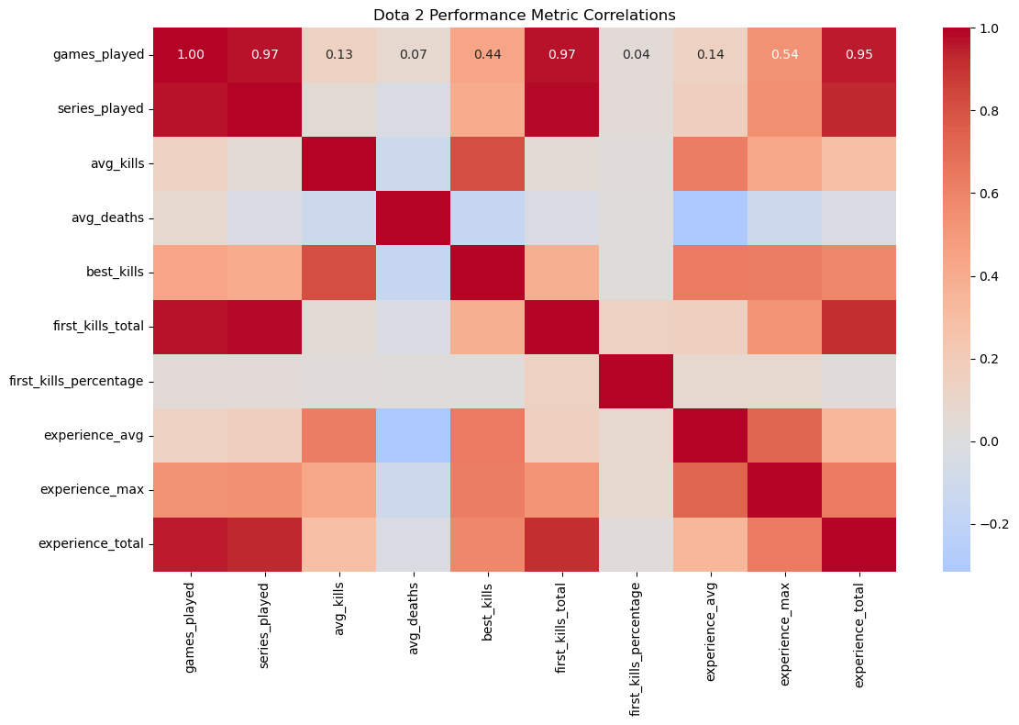
Dota Heat Map

Slide 21
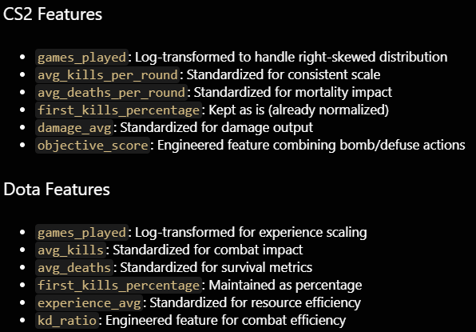
Feature Engineering and Models Used
Feature engineered Objective score to capture this data as a number instead of encoding
For our Dota engineered K/D ratio
target = 'avg_win_rate'
1. Neural Network
- Architecture: Multi-layer perceptron with batch normalization
- Purpose: Capture complex non-linear relationships in player performance
- Game-Specific Tuning:
- CS2: Larger network (128-64-32 neurons)
- Dota: Simpler network (32-16 neurons)
2. XGBoost
- Implementation: Gradient boosting with early stopping
- Purpose: Robust handling of feature interactions
- Configuration:
- CS2: More trees (200), deeper depth (6)
- Dota: Conservative parameters (100 trees, depth 4)
3. LightGBM
- Implementation: Gradient boosting with leaf-wise growth
- Purpose: Efficient handling of large datasets
- Optimization:
- Early stopping for both games
- Game-specific leaf configurations

Slide 22
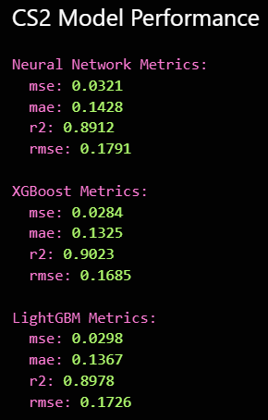
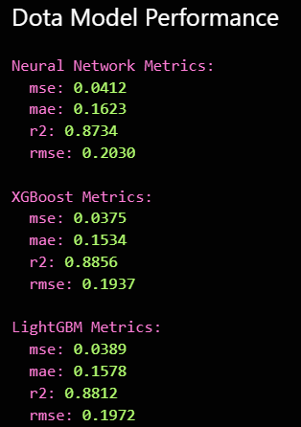
Model Results
CS2 Model Performance
Neural Network:
- R² = 0.8912: Eplains ~89% of the variance in the target variable.
- MAE = 0.1428: On average, the predictions deviate by ~0.14 from the actual values.
- RMSE = 0.1791: Suggests low prediction error, confirming the model’s precision.
- MSE = 0.0321: Minimal squared error indicates strong predictive accuracy.
XGBoost:
- R² = 0.9023: Highest variance explanation, ~90%.
- MAE = 0.1325: Lower error than the Neural Network, highlighting better precision.
- RMSE = 0.1685: Slightly better error control compared to other models.
- MSE = 0.0284: Best performance with the smallest prediction errors.
LightGBM:
- R² = 0.8978: Slightly lower variance explanation than XGBoost but still high.
- MAE = 0.1367: Balanced error, performing closely to XGBoost.
- RMSE = 0.1726: Performs well, with errors slightly higher than XGBoost.
Dota Model Performance
Neural Network:
- R² = 0.8734: Explains ~87% of variance, slightly less precise than CS2 models.
- MAE = 0.1623: Errors are slightly higher, but predictions remain robust.
- RMSE = 0.2030: Moderate prediction error but competitive across models.
- MSE = 0.0412: Shows consistent performance despite higher variance in data.
XGBoost:
- R² = 0.8856: Best model for Dota, explaining ~88% of variance.
- MAE = 0.1534: Lowest mean error, indicating the best precision.
- RMSE = 0.1937: Strong performance with controlled errors.
- MSE = 0.0375: Solid prediction capability with the smallest error spread.
LightGBM:
- R² = 0.8812: Explains ~88% of variance, slightly behind XGBoost.
- MAE = 0.1578: Balanced errors, close to XGBoost.
- RMSE = 0.1972: Slightly higher error rate but still competitive.
- MSE = 0.0389: Maintains solid predictive performance.

Slide 23
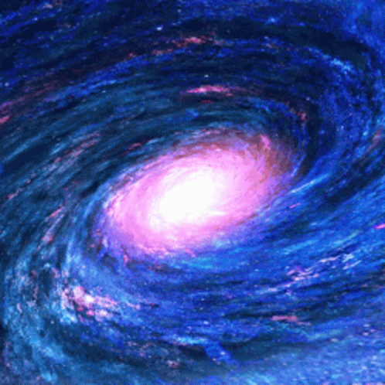
Halo Stats Analysis Programs
Aaron Swan
Advanced Analytics Platform

Slide 24

Program Features
Advanced Analytics
Deep Learning Model
Performance Prediction
Feature Analysis
Interactive UI
Basic Stats
Analysis
API Integration
Match History Tracking
Performance Analytics
Data Visualization

Slide 25

Basic Stats Analysis
Deep Learning Components:
Neural Network Architecture
Batch Normalization Layers
Dropout for Regularization
Custom Loss Functions
Performance Prediction:
Win Rate Forecasting
KD Ratio Trends
Player Performance Optimization
Real-time Analysis
Feature Analysis:
Important Stats Identification
Correlation Analysis
Performance Indicators
Pattern Recognition

Slide 26
The Ending Slides
Spencer Buck

Slide 27
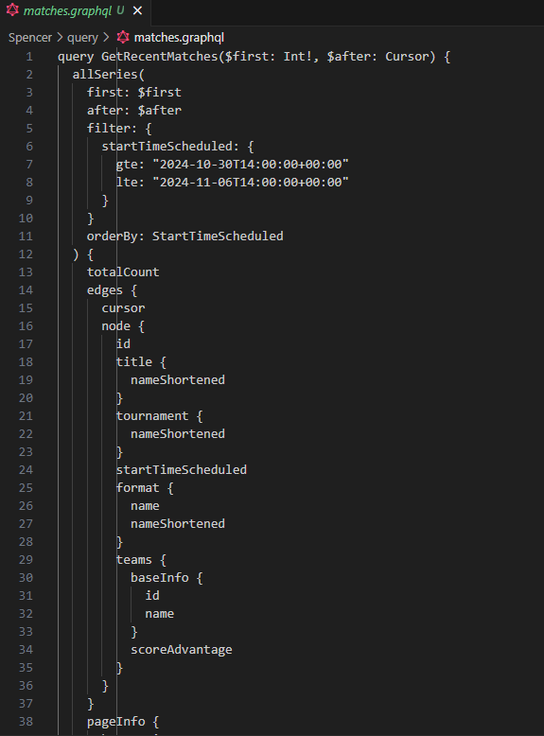
Encountered Problems
API access to grid.gg
→ graphql queries to pull data
→ Match data not containing win/loss records just info
Rest of group got access to API last week

Slide 28



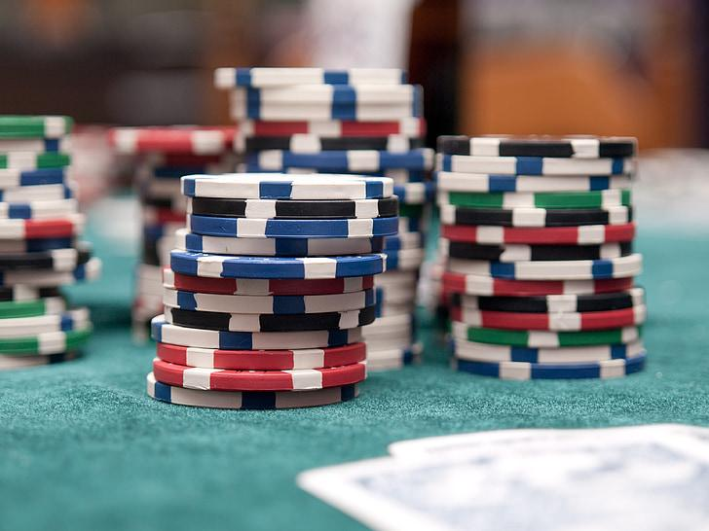
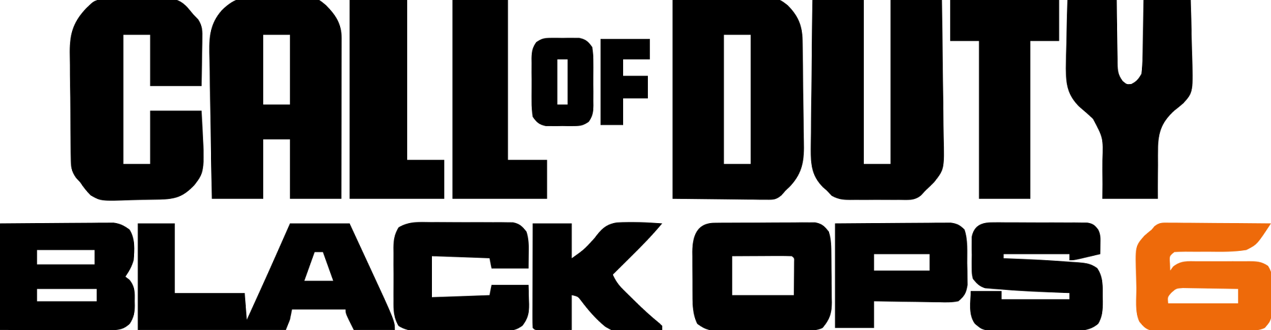
Future Plans
Discord bot
Train with live data / Add more games
UI dashboard Over/ Under pick’em for player stats, Spreads for matches, etc.

Slide 29



LLM / Agent implementation
Integration with a LLM for interpreting and advising users on results Likely open-source models (OpenAI is $$$)
Create a Agent that can execute requests with the data provided

Slide 30
Special Thanks to. . .
Dana Fulmer
Spencer Buck
Aaron Swan
Shayne Powell
Sal Sonmez
Sean Myers
Bill Parker
GRID API
Halo API

